Slide 1
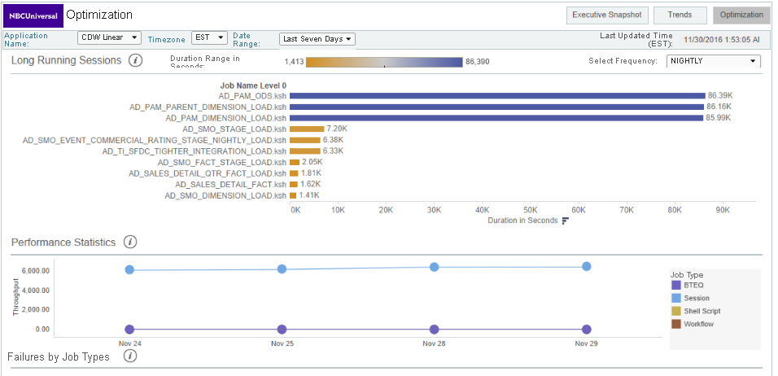
EACS Dashboard – Long Running Sessions & Performance Stats
Long Running Sessions
Performance Statistics

